Slide 1
Spring declarative transaction management pitfalls
may 2019

Slide 2
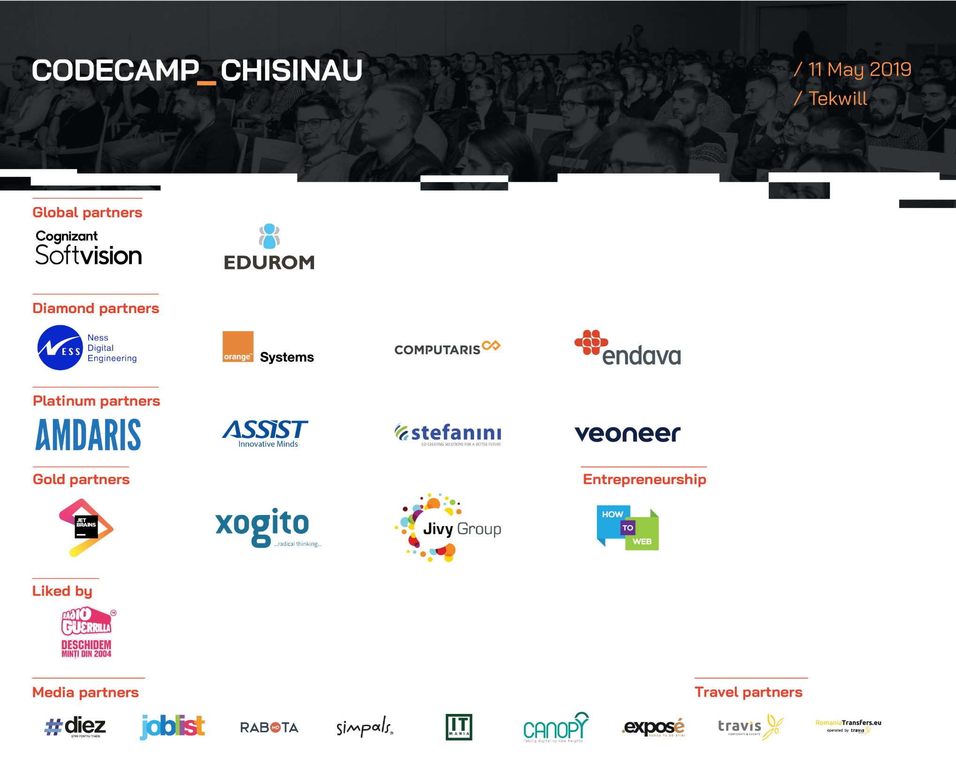

Slide 3

Why use transactions?

Slide 4
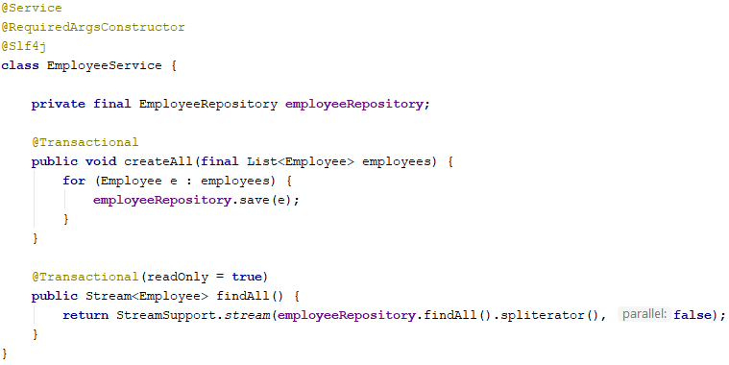

Slide 5
Live coding: #1

Slide 6
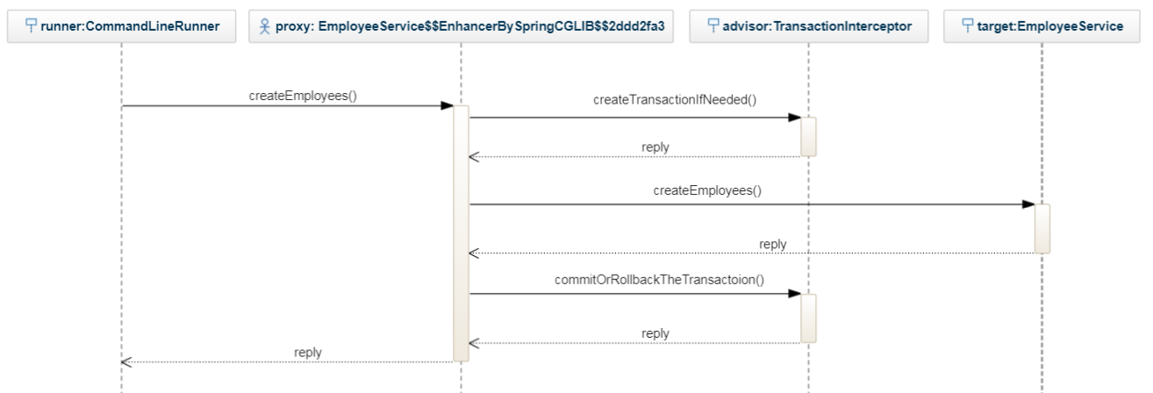
What we have

Slide 7


Slide 8
Live coding: #2

Slide 9
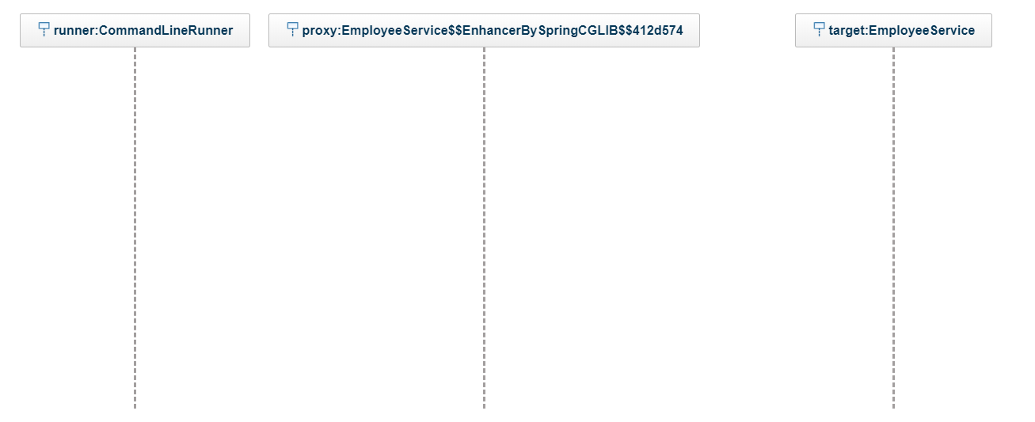
Proxy-based transactions flow

Slide 10
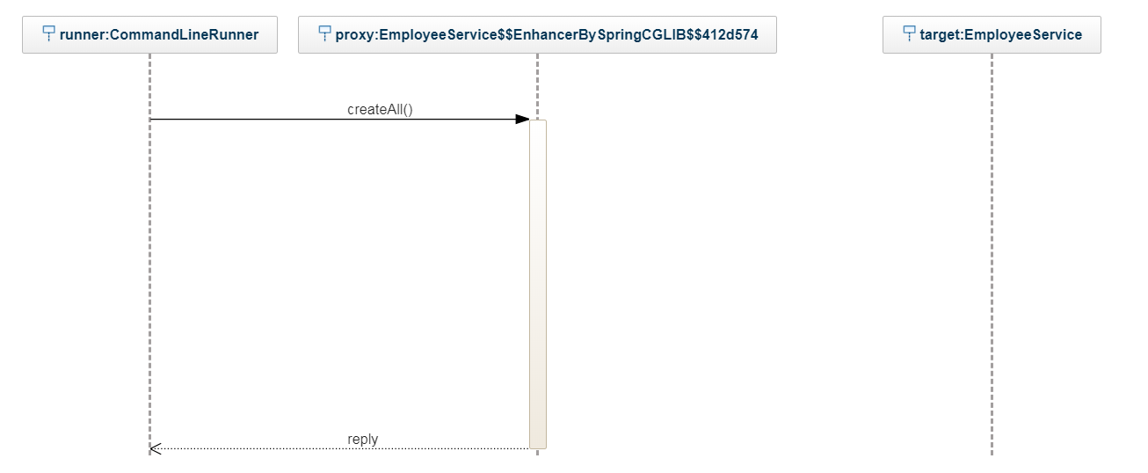
Proxy-based transactions flow

Slide 11
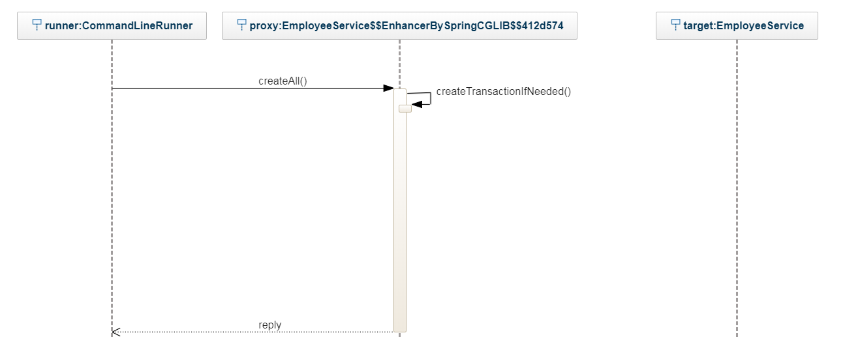
Proxy-based transactions flow

Slide 12
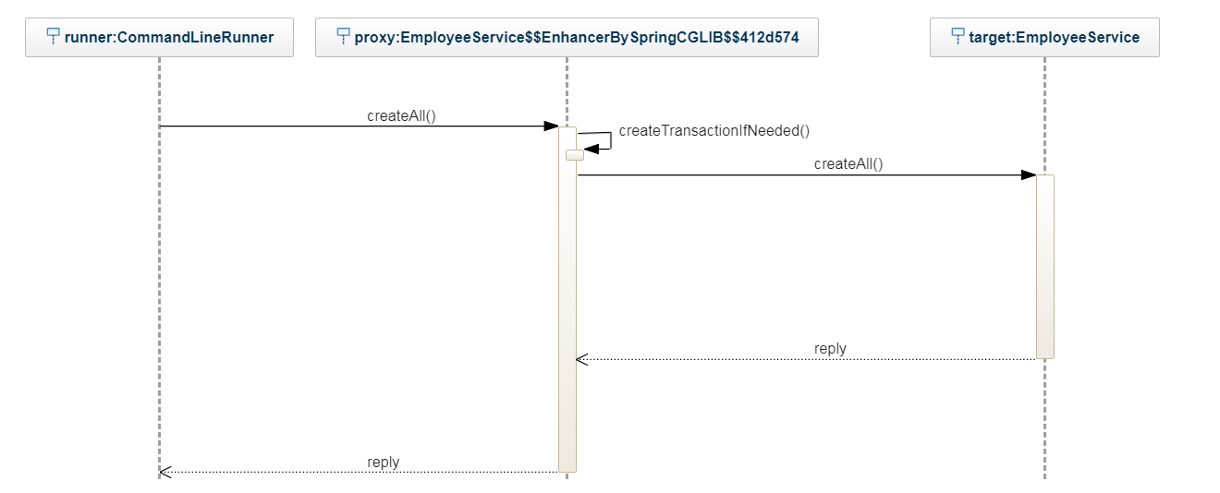
Proxy-based transactions flow

Slide 13
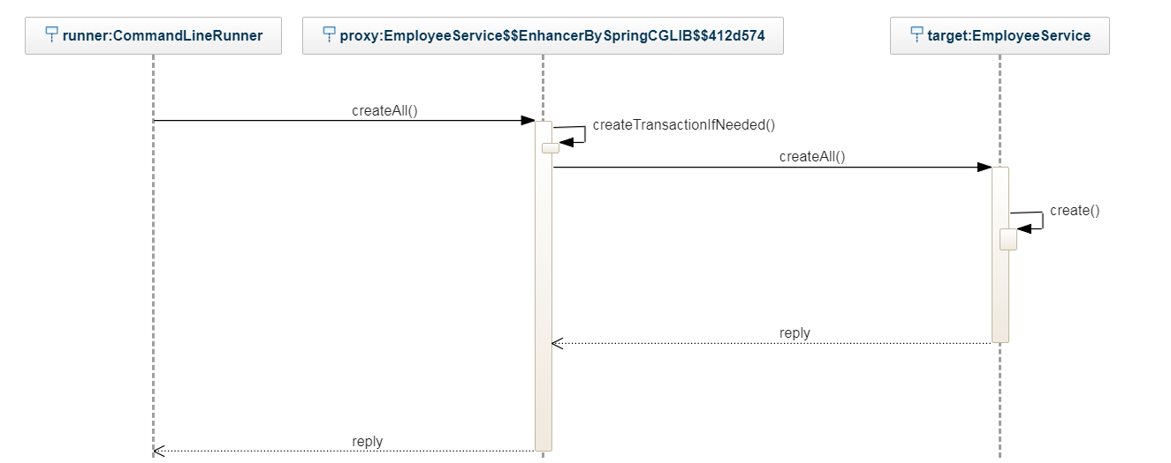
Proxy-based transactions flow

Slide 14
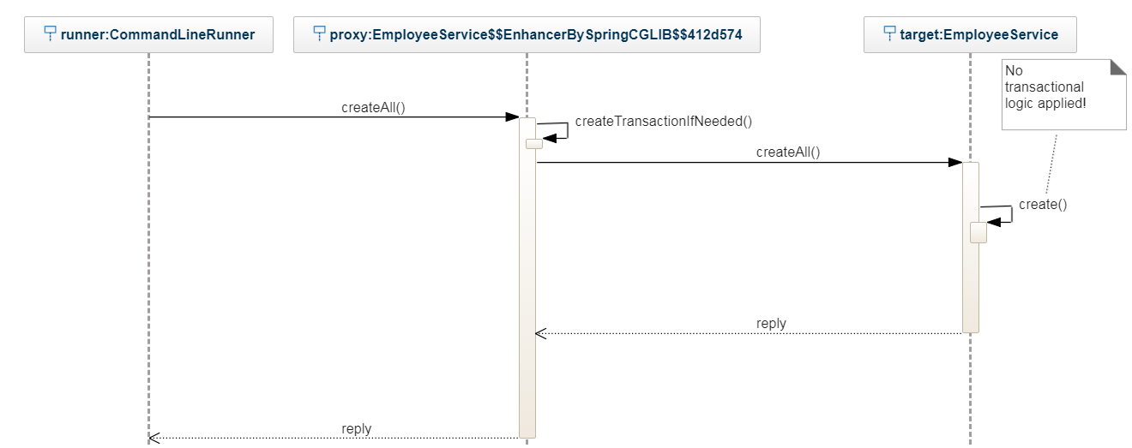
Proxy-based transactions flow

Slide 15
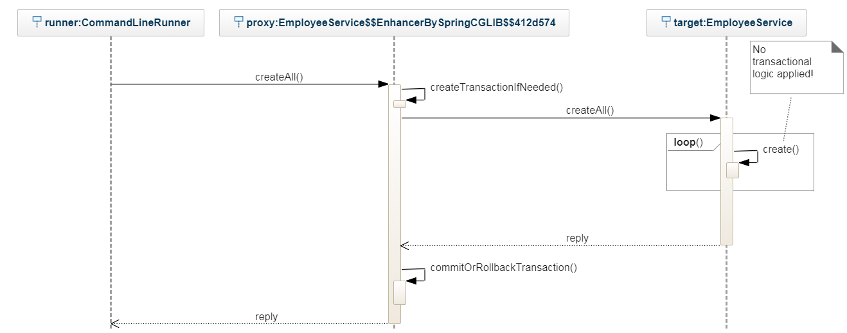
Proxy-based transactions flow

Slide 16
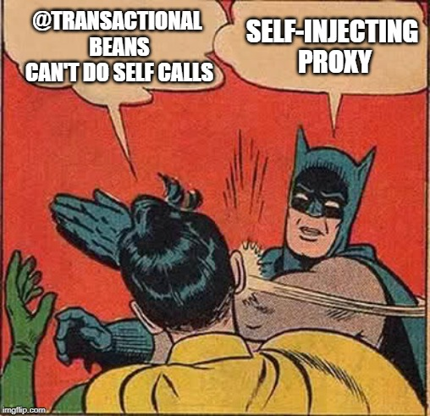

Slide 17
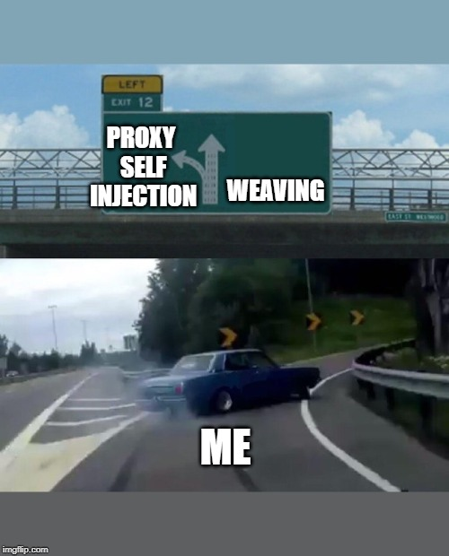
???

Slide 18
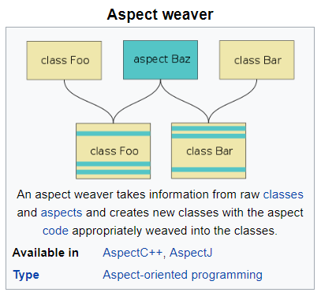
Introduction to Weaving
https://en.wikipedia.org/wiki/Aspect_weaver

Slide 19
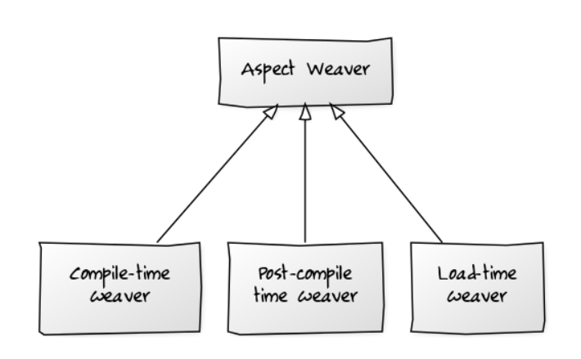
Weaving types

Slide 20
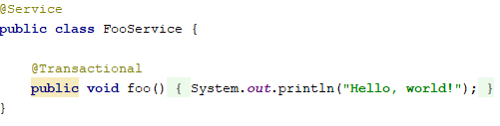
What weaving does

Slide 21
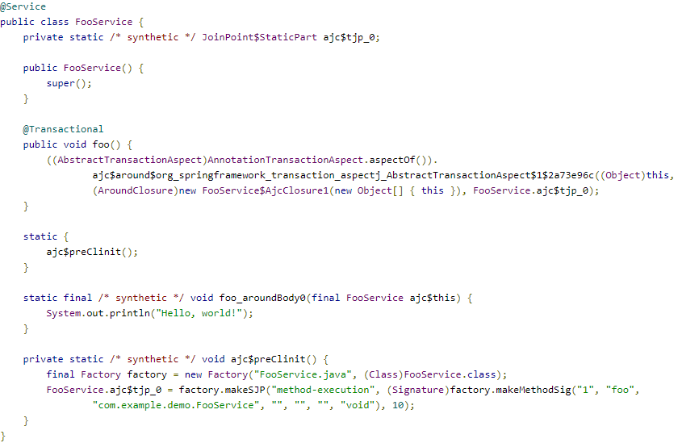
What weaving does

Slide 22
What weaving does
Original method body

Slide 23


Slide 24
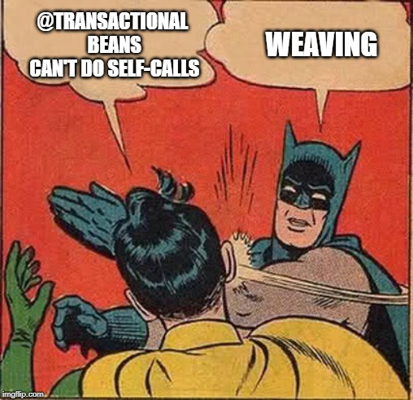

Slide 25
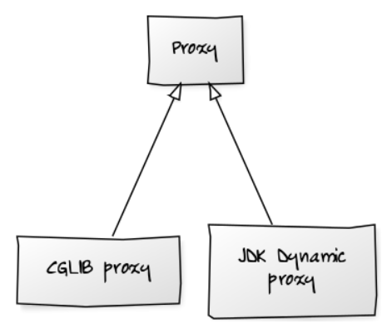
Proxy types

Slide 26
Proxy types

Slide 27
Proxy types

Slide 28
Proxy types
Interface based

Slide 29
Proxy types
Class based
Interface based

Slide 30
Proxy types
Class based
Interface based
Silently ignores final methods

Slide 31
Proxy types
Class based
Interface based
Silently ignores final methods
Default since Spring Boot 2.0

Slide 32
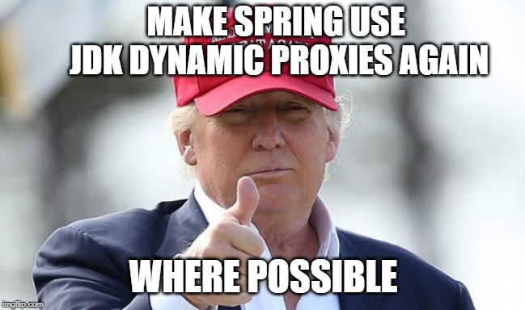

Slide 33
Make spring use JDK dynamic proxies if possible

Slide 34
Make spring use JDK dynamic proxies if possible
1.

Slide 35
Make spring use JDK dynamic proxies if possible
1.
2.

Slide 36
Make spring use JDK dynamic proxies if possible
1.
2.
3.

Slide 37
Make spring use JDK dynamic proxies if possible
1.
2.
3.
4.
It can’t be done. Spring doesn’t support JDK dynamic proxies anymore

Slide 38

Make spring use JDK dynamic proxies if possible
1.
2.
3.
4.
It can’t be done. Spring doesn’t support JDK dynamic proxies anymore

Slide 39
Live coding: #3

Slide 40
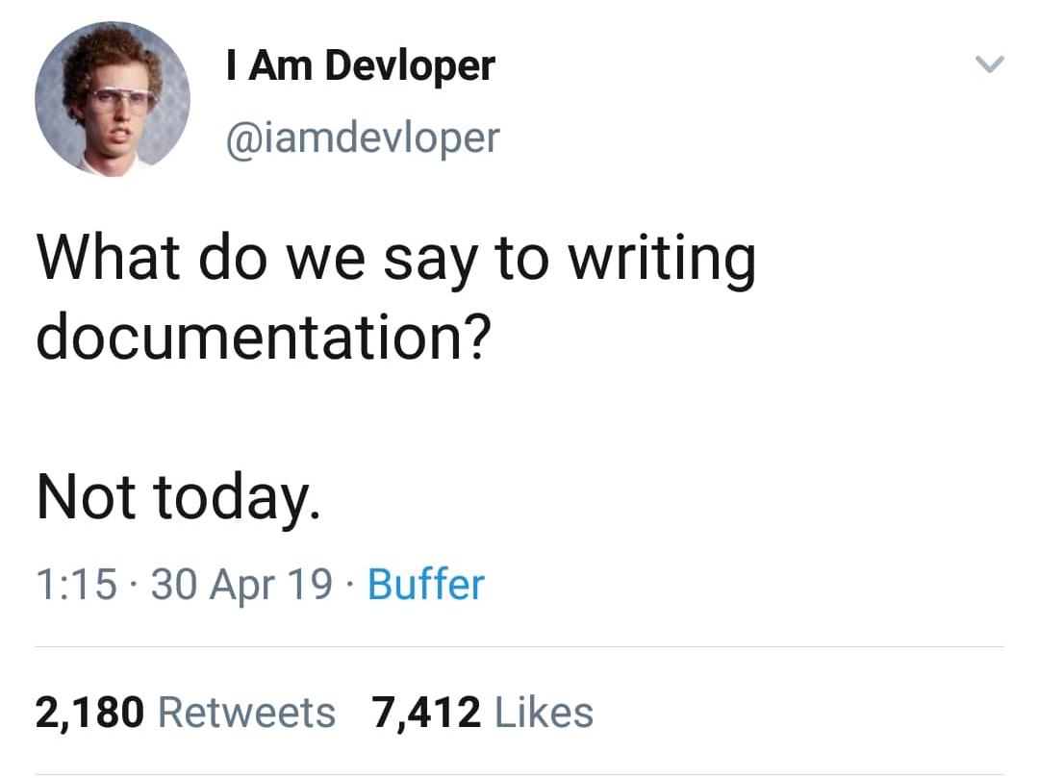

Slide 41
Live coding: #4

Slide 42
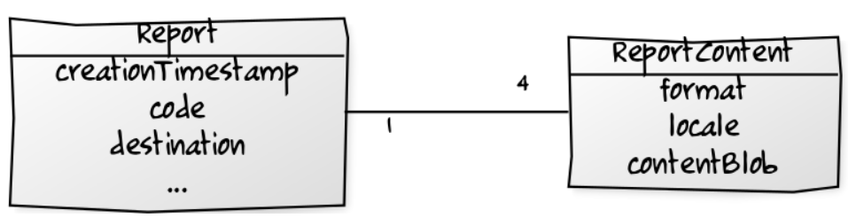
Data model

Slide 43
Recap
The most common pitfall is “the self-call problem”

Slide 44
Recap
The most common pitfall is “the self-call problem”
It can be solved via

Slide 45
Recap
The most common pitfall is “the self-call problem”
It can be solved via
Proxy self-injection (ugly but works)

Slide 46
Recap
The most common pitfall is “the self-call problem”
It can be solved via
Proxy self-injection (ugly but works)
Weaving (bulletproof but overkill)

Slide 47
Recap
The most common pitfall is “the self-call problem”
It can be solved via
Proxy self-injection (ugly but works)
Weaving (bulletproof but overkill)
Code restructuring (usually the best choice)

Slide 48
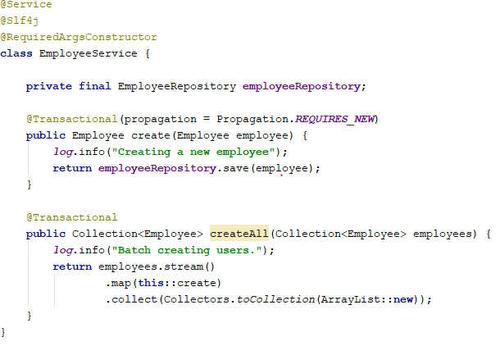

Slide 49
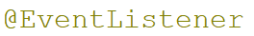
Recap
Use instead of
If the event was fired from a transaction

Slide 50

THANK YOU
Andrei Roșca
Java developer
Andrei.Rosca@endava.com

